Slide 1


New Technology, New Future!
By Richard Jiang
The future is present -----Mobile Team

Slide 2

Agenda
Introduction.
New Technology.
The main objects.
The plan of Time.

Slide 3
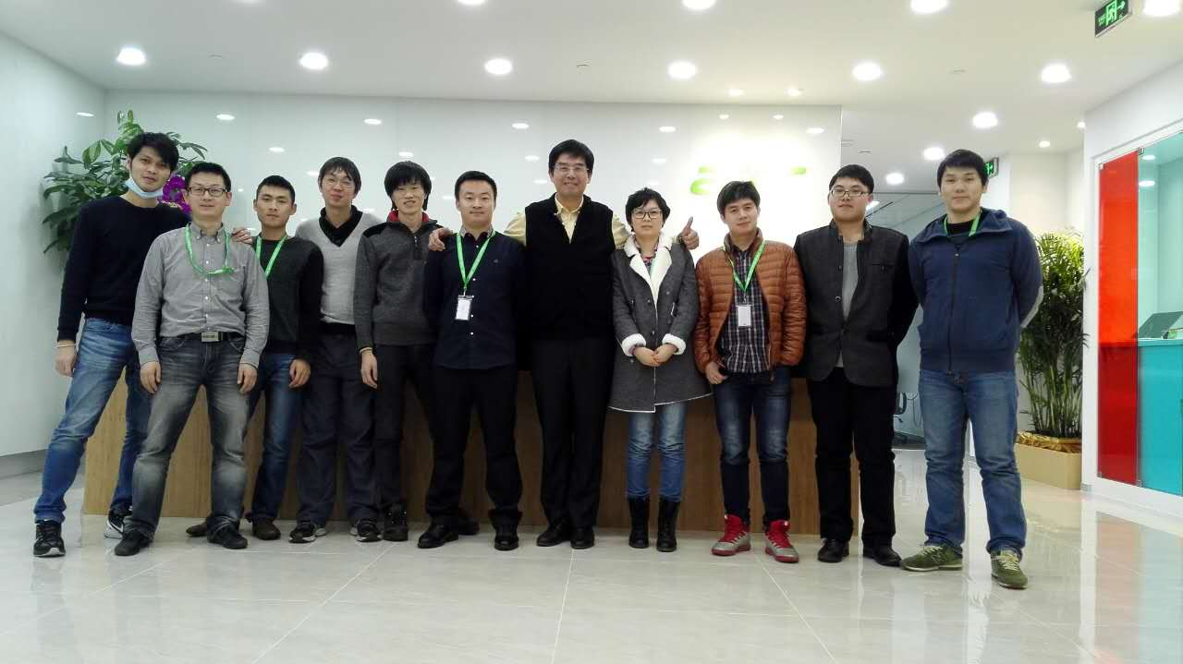
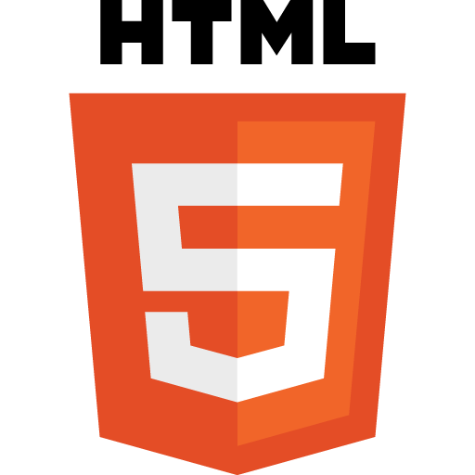

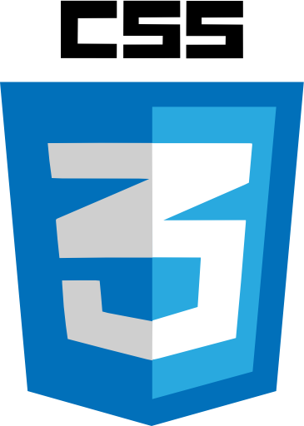

Memorable Time

Slide 4




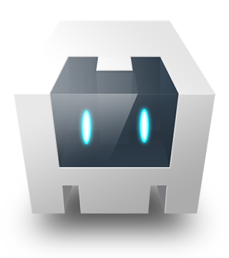
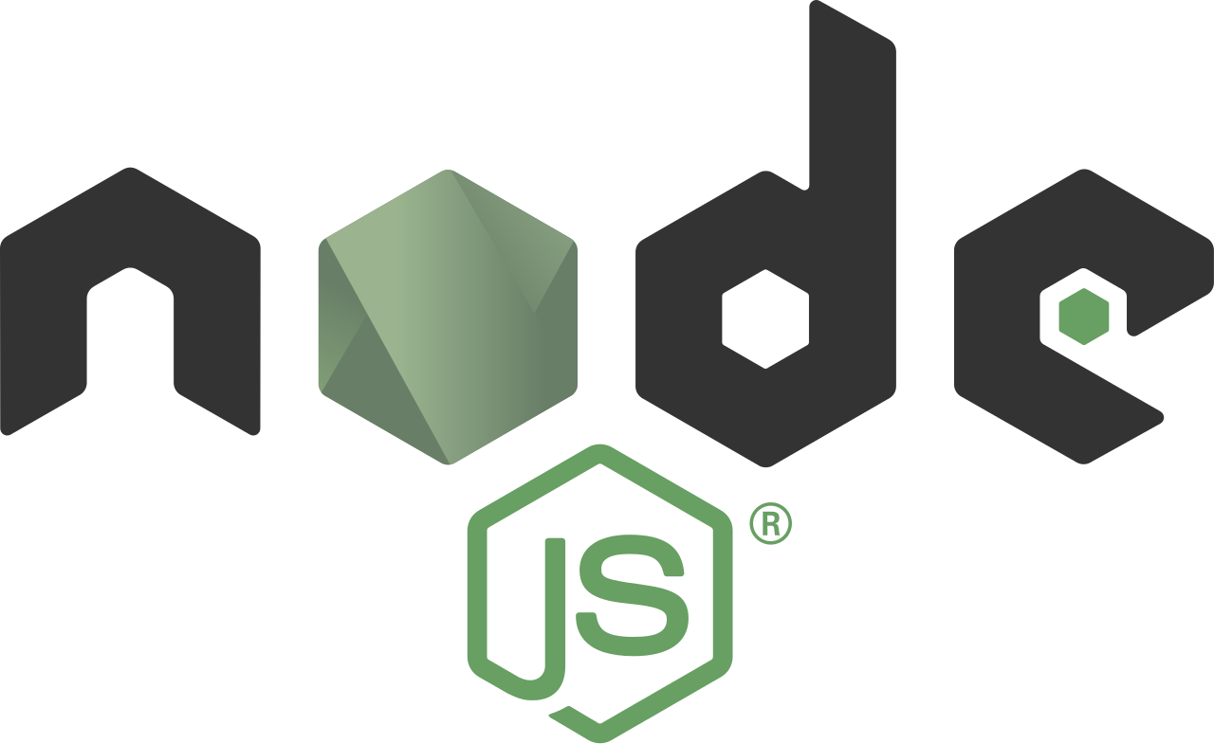
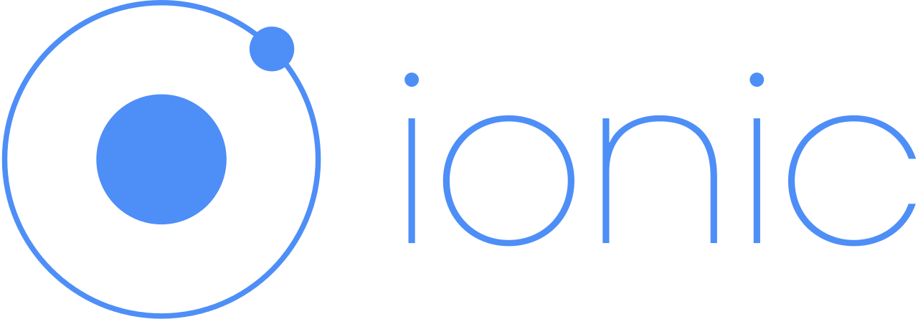


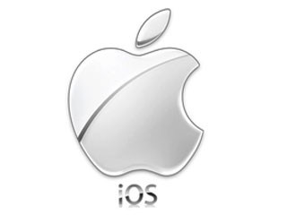

Technology In Last Time
......

Slide 5

What’s the new in 2016?

Slide 6
How many types for HTML5 Applications?
Native
Run fast
Mature Technology
Hybird Web
Native Language +
HTML5
Multiple platform
Hybird Mixed
Mobile Web
Native language
NativeLanguage+HTML5
To extend native function.
Apply html5 features
JavaScript
Run in browser.
Multiple platform
Apply native function.

Slide 7
HTML5 Framework In 2016
Angular 2.0 is new framework, made by google, it is very different with Angular 1.x. In other side, it is based on components, released on 9, 2016.
There are two frameworks(React+ React-Native), it is made by Facebook and based on components, it is very popular framework for now!

Slide 8
What will we show in this session?

Slide 9
Some Functions on Acer II, It is only demo case.
Native Driver Mobile App.
Influence From System Upgrade.
To Optimize Hybird App.
New Architecture
.
ES6

Slide 10
Changes From System IOS Upgrade
To add description for camera, location…
<allow-intent href="tel:*" />.
Better to use HTTPS for our application.
To configure the whitelist on ios 9.0+

Slide 11
Changes From System Android Upgrade
Permissions your way.
Performance Monitor.
Upgrade Platforms.
To access Internet.

Slide 12
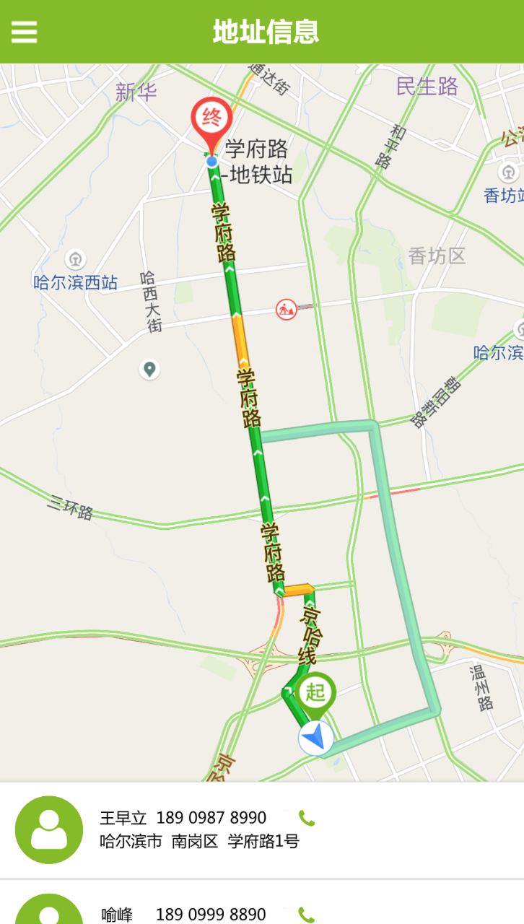
Map Function in Hybird Application.
How to make the route and marker?
How to implement the navigation function?
How to open external baidu map?
How to configure on different platforms?

Slide 13
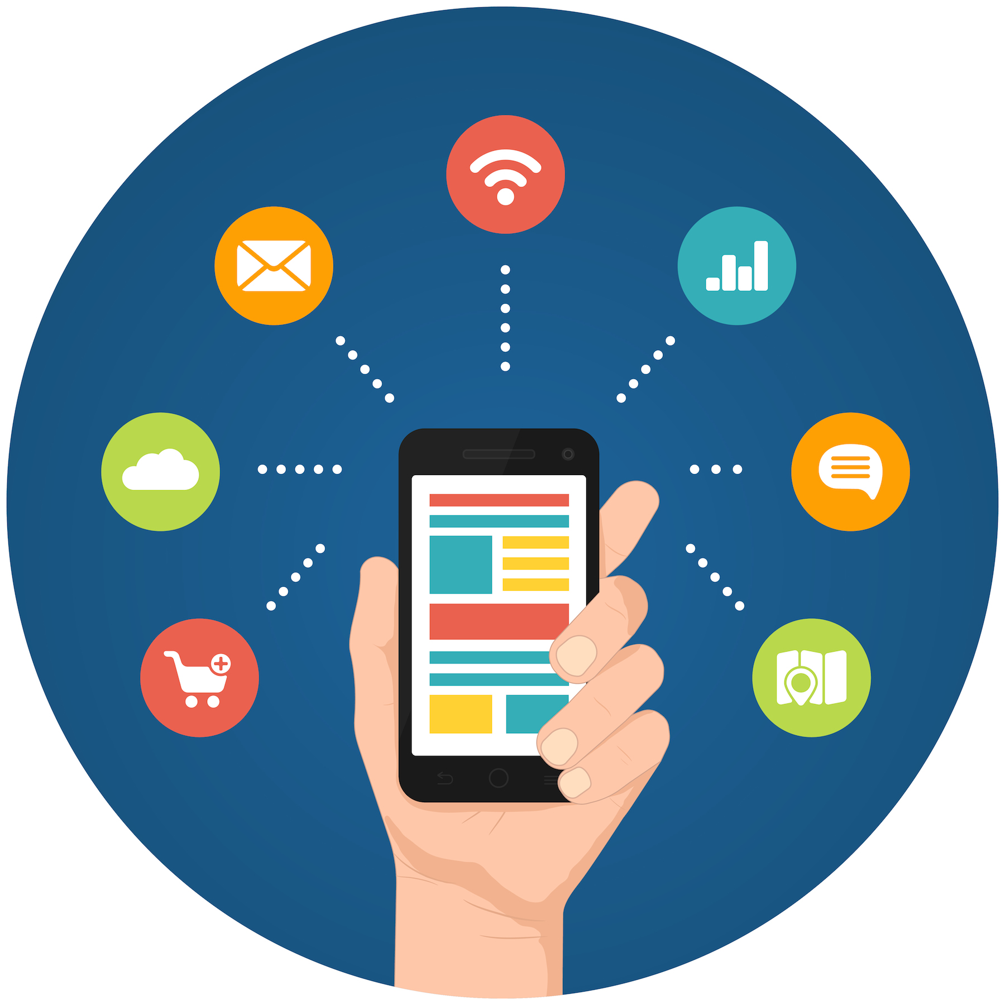

How to optimize the big Hybird app?
……..
Much More Data
To meet complex logics
Much More views
more native characteristic
Cache Management
Big file upload and download

Slide 14
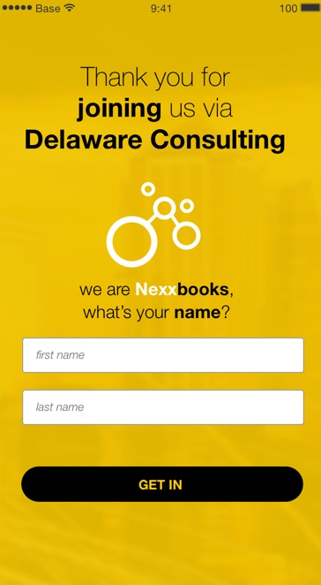
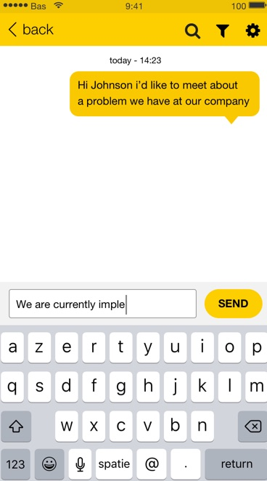
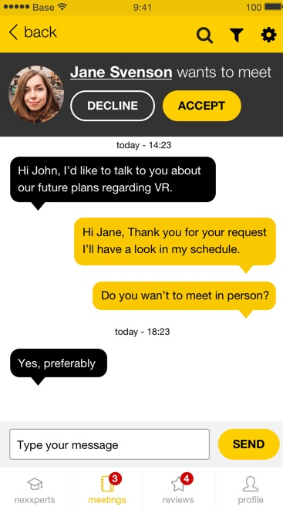
Instant Message By Hybird App(Real Case)

Slide 15

Hot Update For Hybird Application
It is difficult to debug and testing on real device.
It is not easy to update App version.
It is not able to rollback last version.

Slide 16
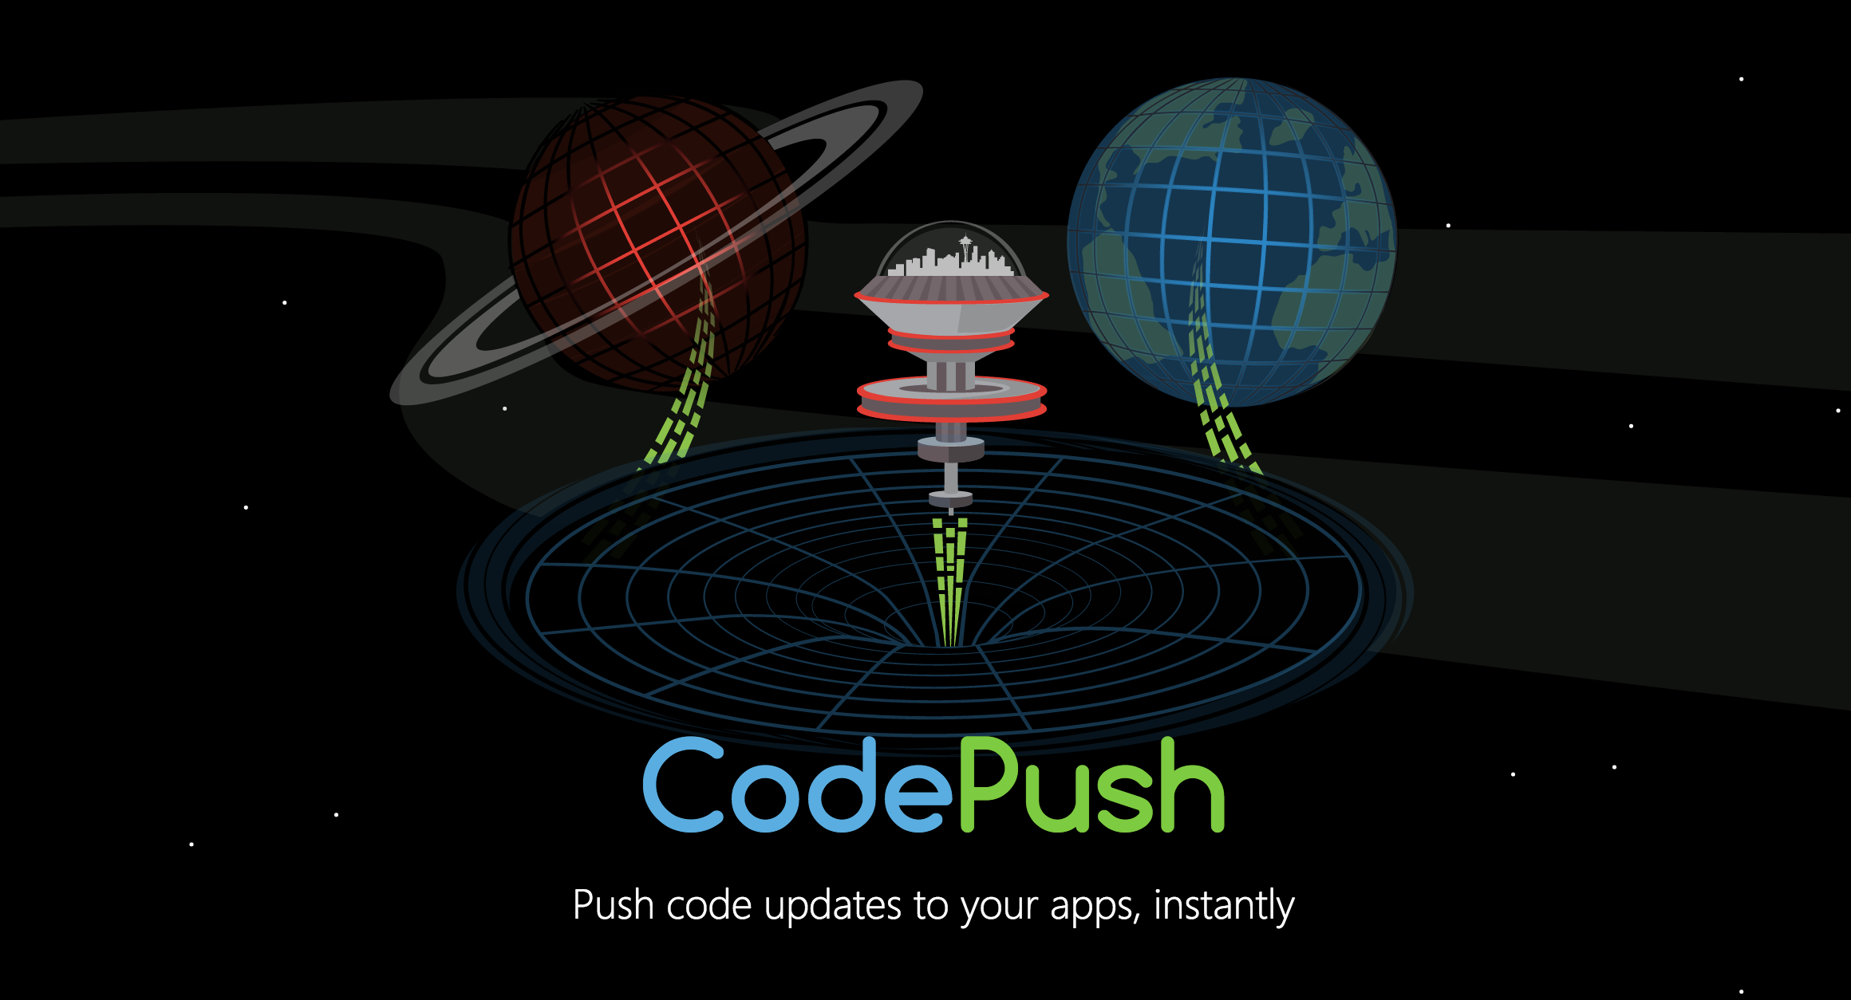
Open Source From Microsoft

Slide 17

Why is CodePush?
Open source from Microsoft.
Have a good performance.
Release any files(eg. Image, js, css)
Support rollback last version.

Slide 18
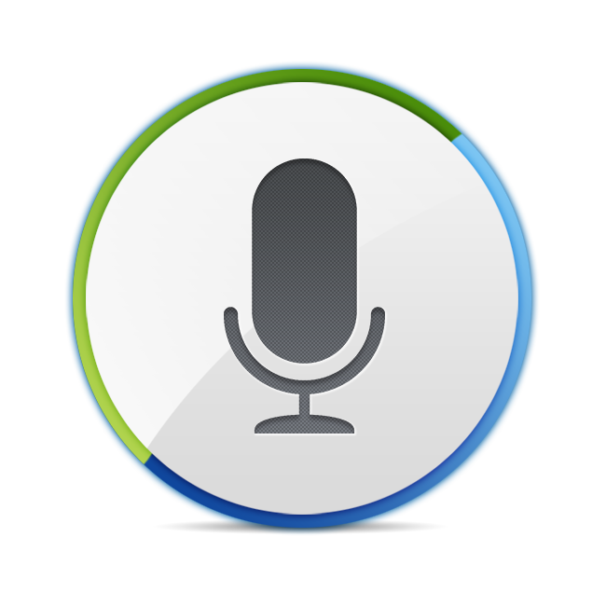
Record Audio and breakpoint upload
Record Audio By MPEG4(.m4a)
Upload big file by Socket Service.
Can support pause and restart.
Simple Demo case for this function.

Slide 19
React-Native For Mobile App
Made by Facebook, it is open source.
Based on Components.
Native Driver Application.
It is very popular and widely used for now.

Slide 20


Slide 21

What is the future?
Native App
Hybird App
Native Driver

Slide 22

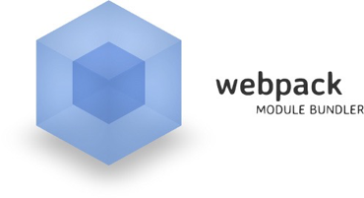
Build Tools For React

Slide 23
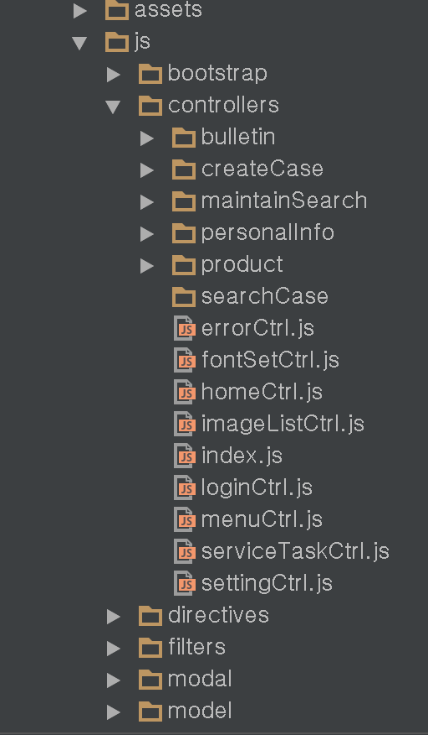
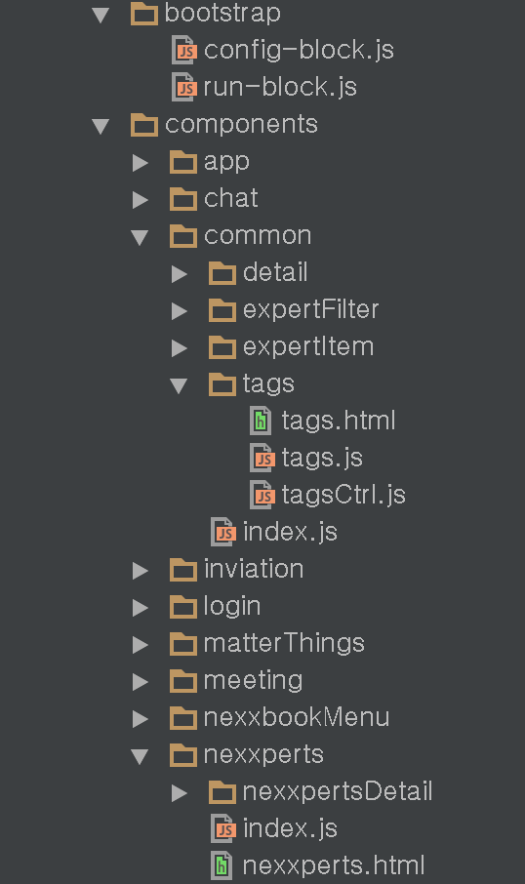
Architecture Update base on Components

Slide 25
Programming By ES6
Advantage
Support class, import, extend.
Much more Syntactic sugar
Disadvantage
The browser don’t have a good support.
Need to convert by babel library.
Easy to learn and read.
Support arrow function.
…..

Slide 26
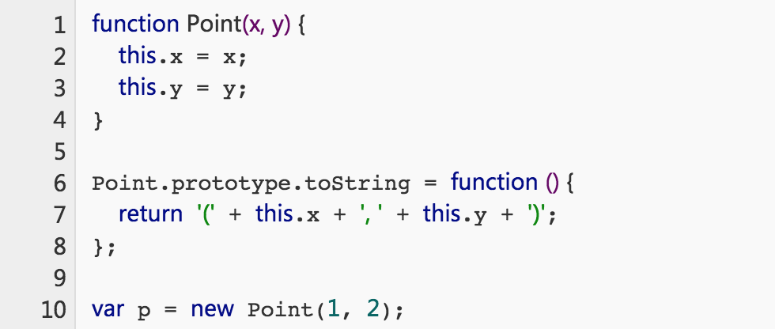
Programming By ES6
ES5 Syntax

Slide 27
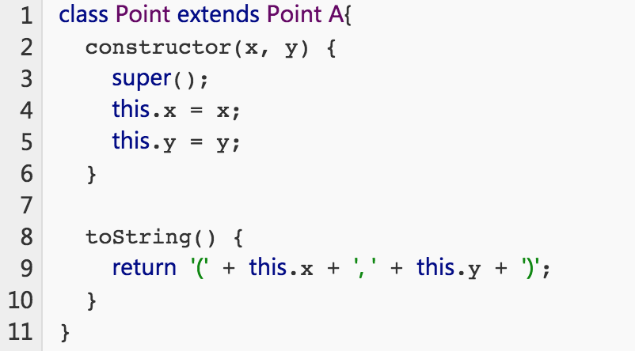
Programming By ES6
ES6 Syntax

Slide 28


Slide 29
本次技术交流时间计划简要.
Hybird移动应用系统升级过程中疑难问题解答 （0.25 天）
语音录制及断点上传功能在移动应用中的解决方案 （0.25 天）
大数据多页面混合型移动应用的优化实践方案 （0.5 天）
混合移动应用中地图导航功能开发讲解 （0.5 天）
热更新云服务在Hybird移动应用中的实践与探索 （0.5 天）
React-Native驱动原生型移动应用开发的跨平台实践 （0.5 天）

